Slide 1


CMR TECHNICAL CAMPUS
UGC(Autonomous)
Kandlakoya,Medchal Road,Hyd-501 401 Department of Computer Science Engineering
Major Project On
LANGUAGE IDENTIFICATION FOR MULTILINGUAL MACHINE TRANSLATION
BATCH NO : 17
Project Guide: BATCH MEMBERS:
Ms. Raheem Unnisa 217R1A0590 G SRAVIKA REDDY
Assistant Professor, CSE Department 217R1A0586 E SAI KUMAR
217R1A0587 G BHAVISH REDDY
Project Coordinator:
Dr. J. Narasimharao
Associate Professor, CSE Department

Slide 2
CONTENTS
Abstract
Existing System
Disadvantages
Proposed System
Advantages
System Requirements
Novelty of Project
System Architecture
Modules
UML Diagrams
Sample Code
Results
Conclusion
Future Scope
References

Slide 3
ABSTRACT
Machine translation is the process of translating a text in one natural language into another natural language using computer system.
Translating a document containing a single source language content is easy but when the information in the source document is given in multilingual format then there is a need to identify the languages that are involved in such multilingual document.
Language identification is the task in natural language processing that automatically identifies the natural language in which the content in given document are written in.
In this project, n-gram based and machine learning based language identifiers are trained and used to identify three Indian languages such as Hindi, Marathi and Tamil present in a document given for machine translation.
It is observed that, support vector machine-based language identifier is more accurate than any other technique and it achieves 89% accuracy that is 18% more than traditional n-gram based approach.

Slide 4
EXISTING SYSTEM
Numerous existing systems for language identification have employed traditional algorithms that predate the recent advancements in machine learning.
One of the foundational methods is the K-means clustering algorithm, which groups input texts into clusters based on their linguistic features.
Another classical approach is Gaussian Mixture Models (GMMs), which model the distribution of language features using multiple Gaussian distributions.
Additionally, Hidden Markov Models (HMMs) have been utilized, particularly in speech recognition contexts, for their ability to model sequences of observations.
Lastly, Fuzzy Logic Systems have been explored for their capacity to handle uncertainty in language identification, offering a degree of flexibility that traditional algorithms lack.

Slide 5
DISADVANTAGES
Inability to Capture Complex Patterns: Traditional algorithms often rely on simplistic statistical methods that may not adequately capture the intricate and nuanced patterns inherent in language data.
Short and Ambiguous Texts: Identifying languages in short or ambiguous texts remains a challenge for many systems. Models may struggle with limited context or texts containing multiple languages.
Limited Scalability: Many traditional algorithms, such as K-means and Gaussian Mixture Models, struggle to scale effectively with large datasets.
Low-Resource Languages: Many existing systems perform poorly with low-resource languages due to limited training data and lack of linguistic resources.
Code-Switching: Handling texts with mixed languages (code-switching) requires sophisticated models that can understand and process multiple languages within a single input.

Slide 6
PROPOSED SYSTEM
In our proposed system for language identification, we have implemented and evaluated various machine learning algorithms, including Support Vector Machines (SVM), K-Nearest Neighbors (KNN), and Random Forest.
Each algorithm's performance is rigorously tested using several metrics, such as accuracy, precision, recall, and F1 score, alongside visual representation through confusion matrix graphs.
This comprehensive evaluation allows for a nuanced understanding of each algorithm's strengths and weaknesses in accurately identifying languages across multilingual datasets.
Our findings indicate that Random Forest consistently outperforms the other algorithms, achieving the highest accuracy rates.
This superiority can be attributed to its ability to handle high-dimensional data effectively, reduce the risk of overfitting, and integrate the results of multiple decision trees, thereby enhancing the robustness and reliability of language identification in diverse contexts.

Slide 7
ADVANTAGES
The proposed system Language Identification for Multilingual Machine Translation offers several advantages over existing systems:
Enhanced Accuracy: The integration of advanced models and hybrid approaches improves the accuracy of language identification, particularly in challenging scenarios such as code-switching and low-resource languages.
Scalability: The system's architecture is designed to scale efficiently, handling a broad range of languages and varying text volumes.
Real-Time Efficiency: Real-time processing capabilities ensure that the system can be seamlessly integrated into live multilingual MT pipelines, enhancing overall translation efficiency.
Robust Performance Across Datasets: The use of advanced machine learning algorithms allows the system to perform consistently well across a variety of multilingual datasets.

Slide 8
SYSTEM REQUIREMENTS
HARDWARE REQUIREMENTS:
Processor - Pentium –IV
RAM - 4 GB (min)
Hard Disk - 20 GB

Slide 9
SOFTWARE REQUIREMENTS:
Operating system : Windows Server
Coding Language : Python.

Slide 10
NOVELTY OF PROJECT
The novelty of the proposed Language Identification (LID) system for Multilingual Machine Translation (MT) lies in its ability to handle complex, real-world multilingual scenarios with advanced features not typically found in existing systems.
This includes multimodal language identification, where both text and audio inputs are processed seamlessly, enabling real-time identification in diverse contexts such as live audio streams or video conferencing.
Additionally, the system’s ability to detect and manage code-switching where multiple languages are used within the same sentence or conversation is a critical innovation, ensuring accurate translation of multilingual content.
It introduces hierarchical identification, distinguishing between languages and their dialects, which is essential for improving translation precision.

Slide 11
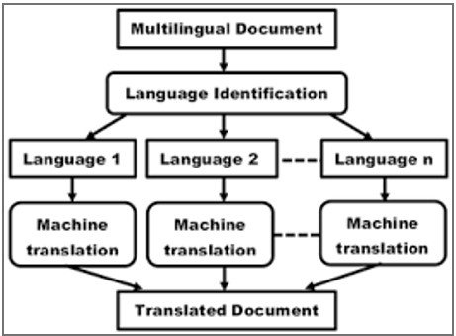
ARCHITECTURE

Slide 12
MODULES
User: In this module user has to give Text as input.
System: In this module user has to preprocess the text, Run the KNN, SVM and Random Forest algorithms, identify the language and translate it into the given requirement with high accuracy.

Slide 13
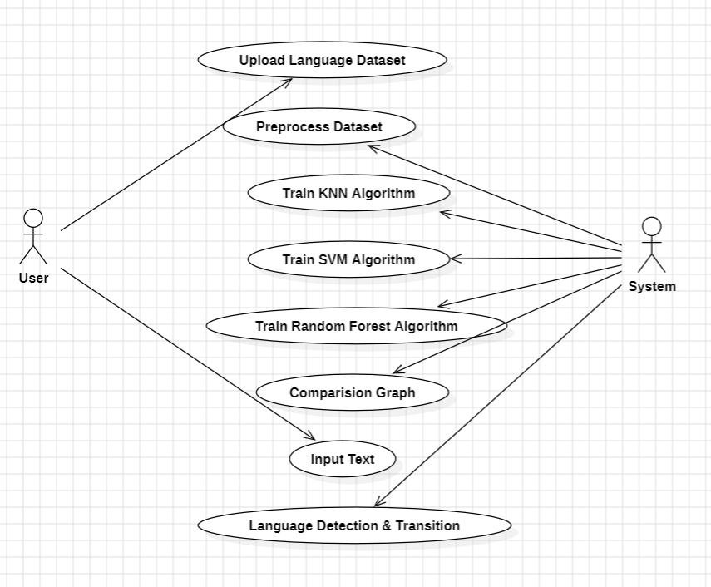
UML DIAGRAMS
USECASE DIAGRAM

Slide 14
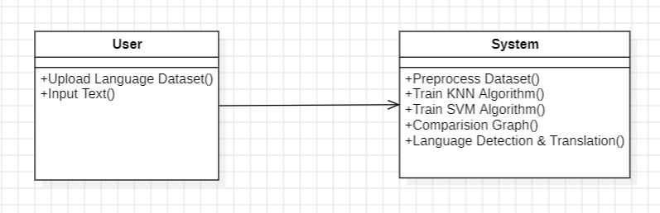
CLASS DIAGRAM

Slide 15
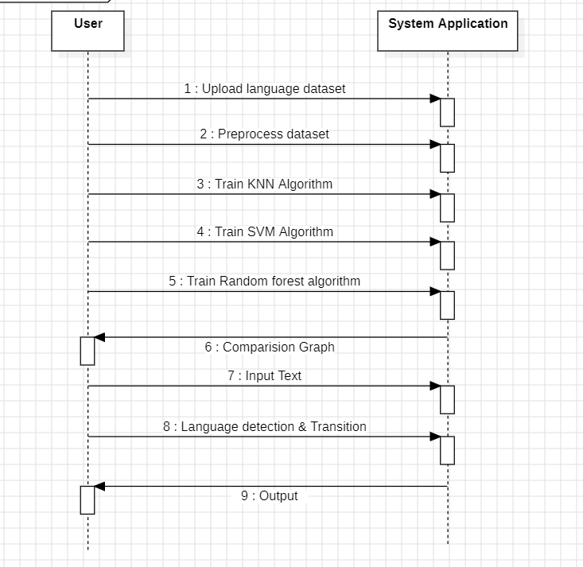
SEQUENCE DIAGRAM

Slide 16
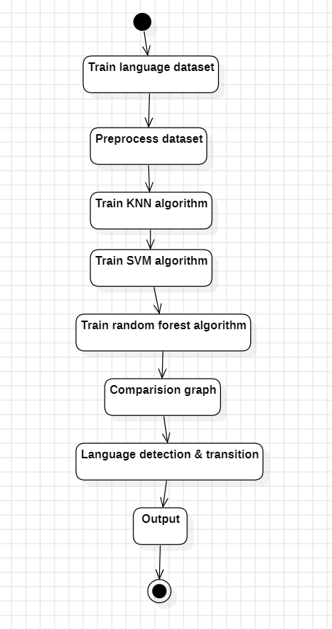
ACTIVITY DIAGRAM

Slide 17
SAMPLE CODE
from tkinter import messagebox
from tkinter import *
from tkinter import simpledialog
import tkinter
from tkinter import filedialog
from tkinter.filedialog import askopenfilename
import numpy as np
import matplotlib.pyplot as plt
import pandas as pd
from sklearn.metrics import accuracy_score
from sklearn.model_selection import train_test_split
import os
from sklearn.metrics import precision_score
from sklearn.metrics import recall_score
from sklearn.metrics import f1_score
from sklearn.preprocessing import LabelEncoder

Slide 18
from sklearn.preprocessing import StandardScaler
import pickle
from sklearn.metrics import confusion_matrix
import seaborn as sns
from sklearn.feature_extraction.text import TfidfVectorizer #loading tfidf vector
from sklearn.neighbors import KNeighborsClassifier
from sklearn.ensemble import RandomForestClassifier
from sklearn import svm
from sklearn.metrics import accuracy_score
from googletrans import Translator
global filename global X,Y
global accuracy, precision, recall, fscore
global X_train, X_test, y_train, y_test, scaler, dataset, tfidf_vectorizer, rf
global labels
main = tkinter.Tk()
main.title("Language Identification for Multilingual Machine Translation") #designing main screen
main.geometry("1300x1200")
translator = Translator()

Slide 19
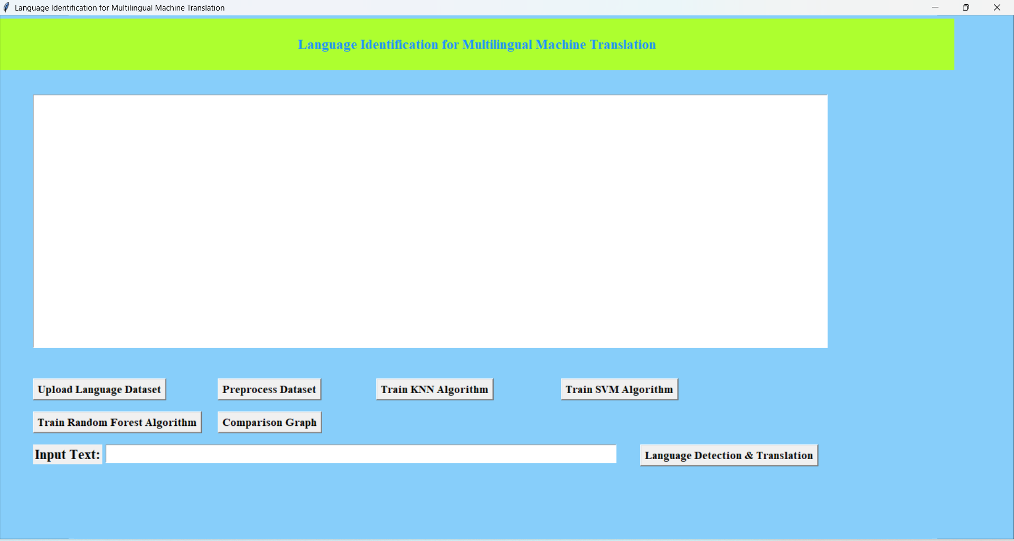
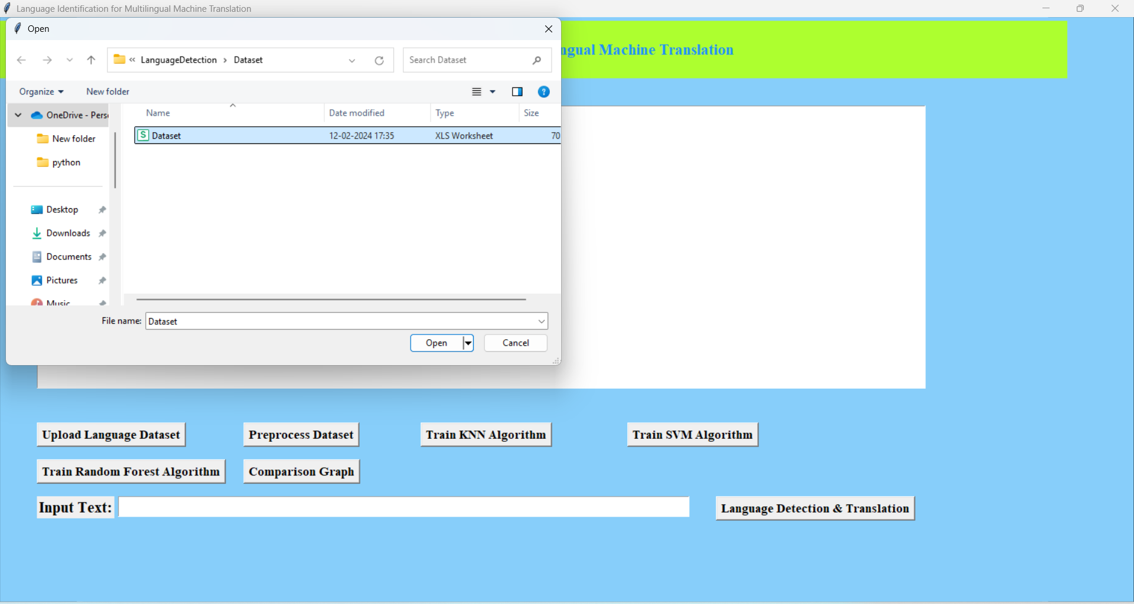
RESULTS
HOME PAGE
UPLOAD DATASET

Slide 20
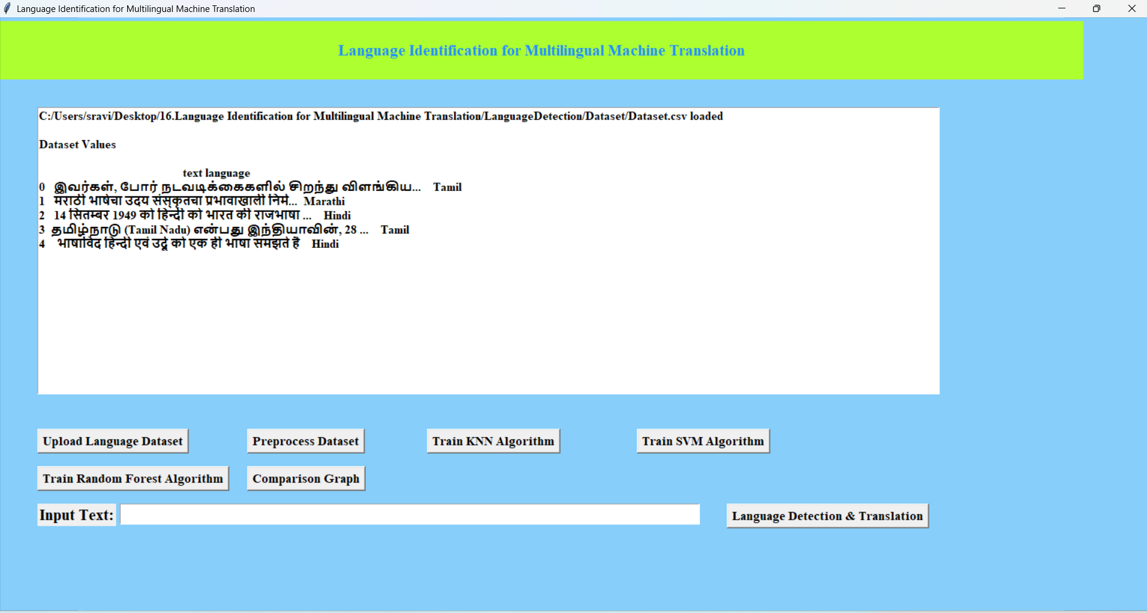
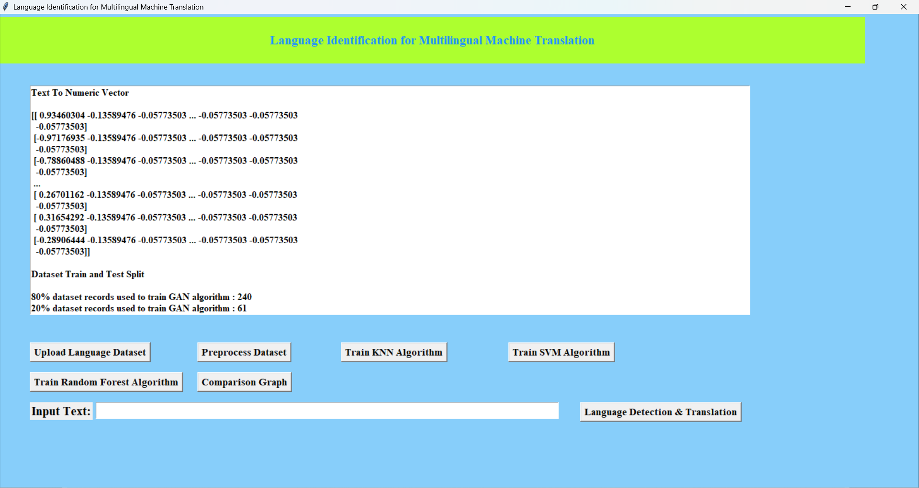
DATASET UPLOADED PREPROCESS DATA

Slide 21
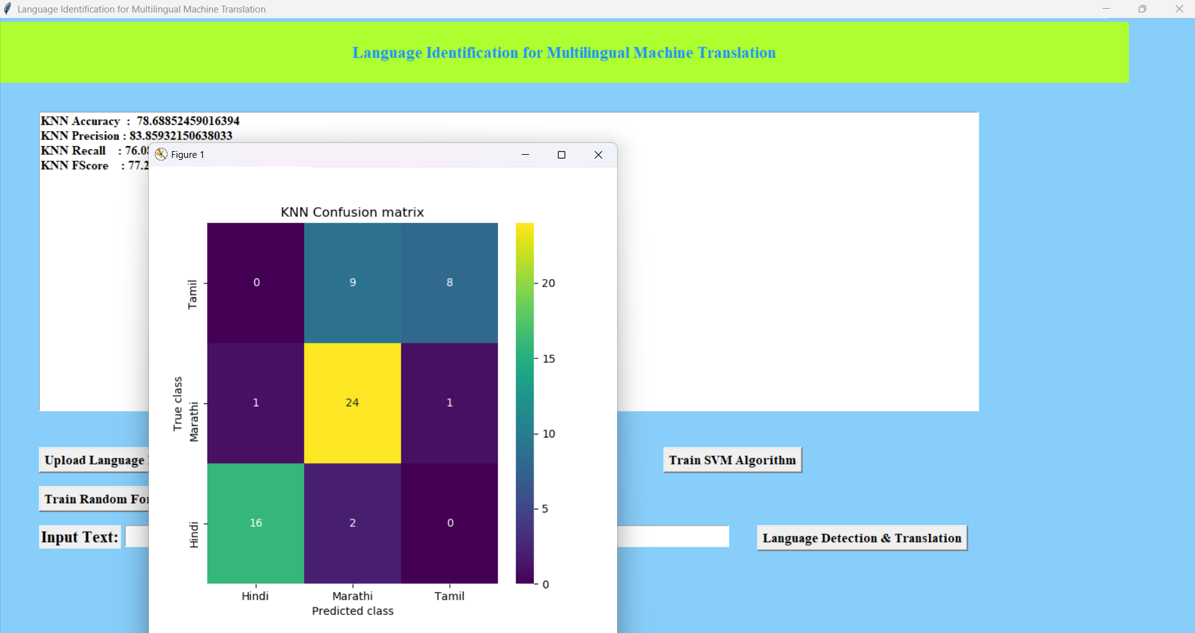
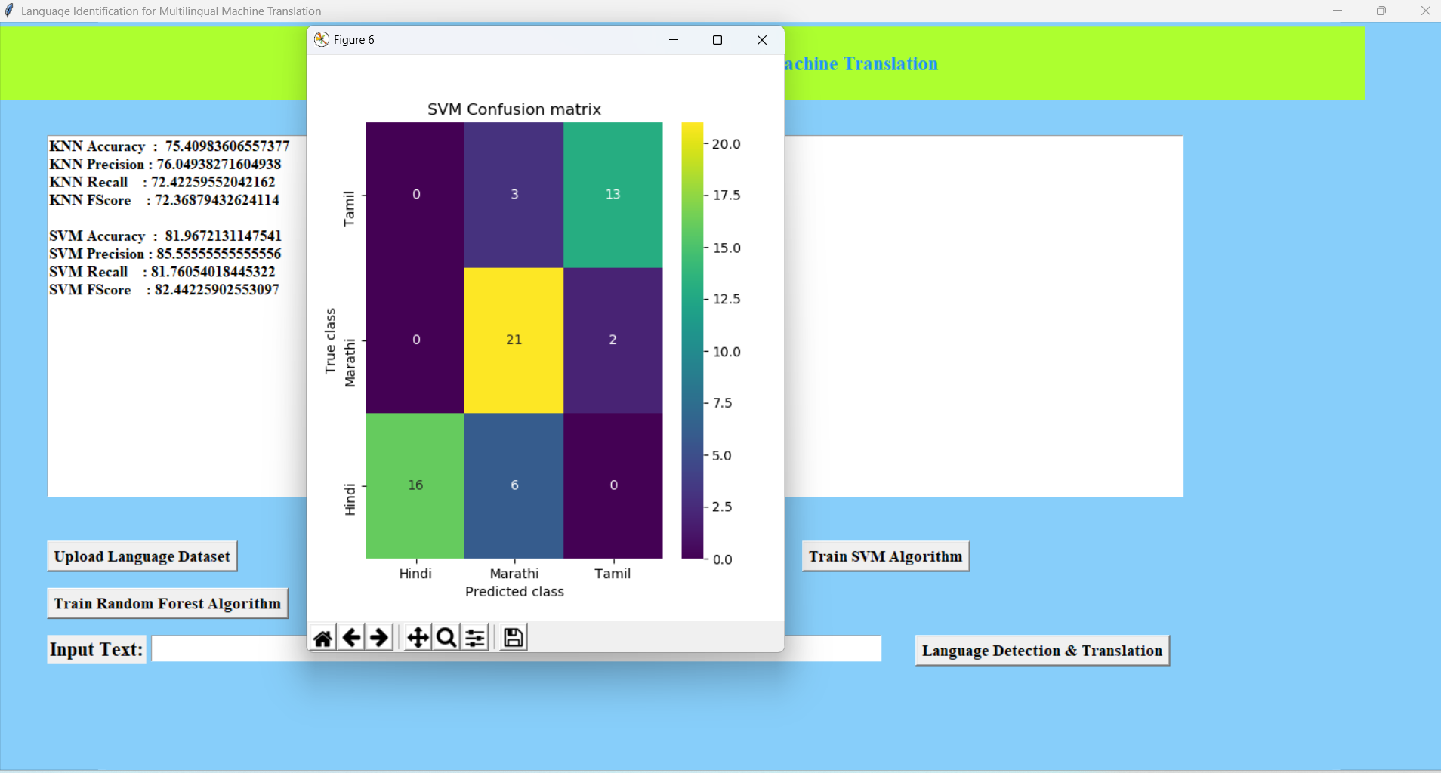
TRAIN KNN ALGORITHM TRAIN SVM ALGORITHM

Slide 22
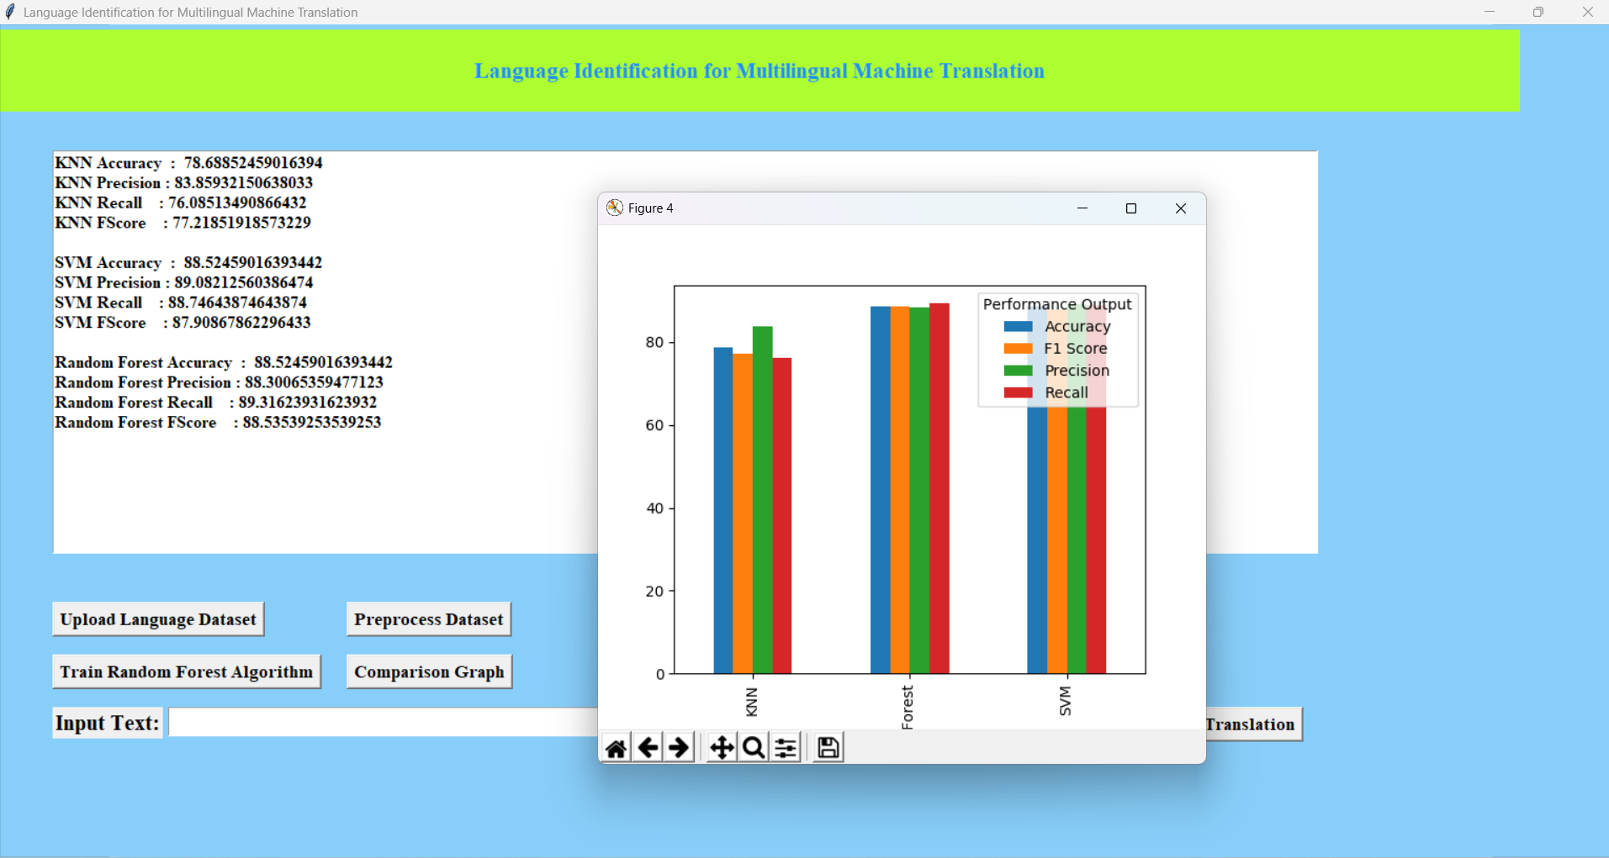
TRAIN RANDOMFOREST CONFUSION MATRIX

Slide 23
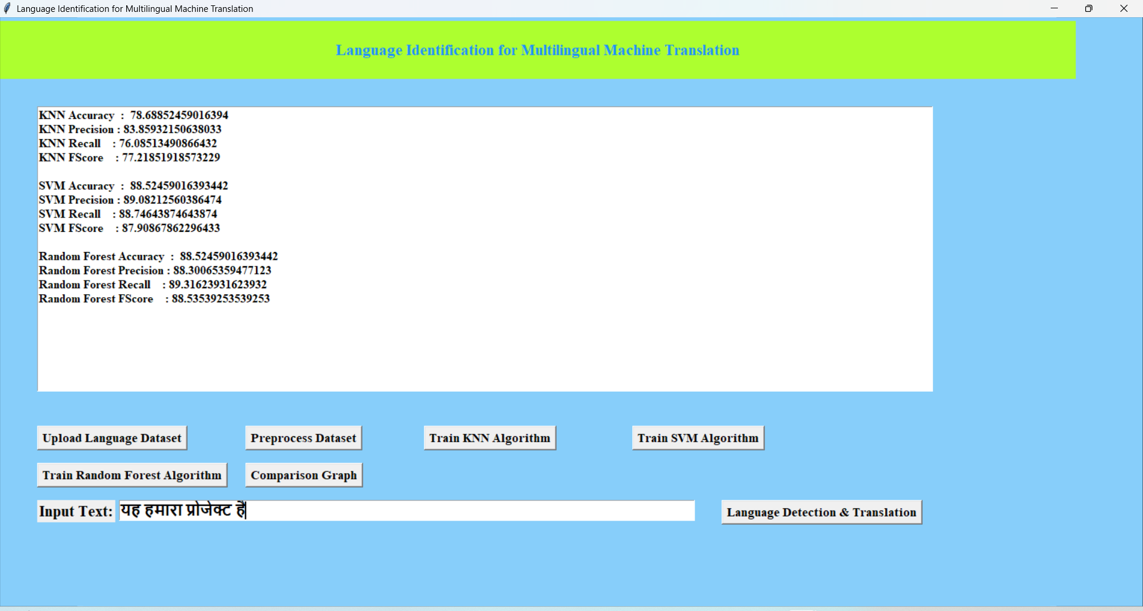
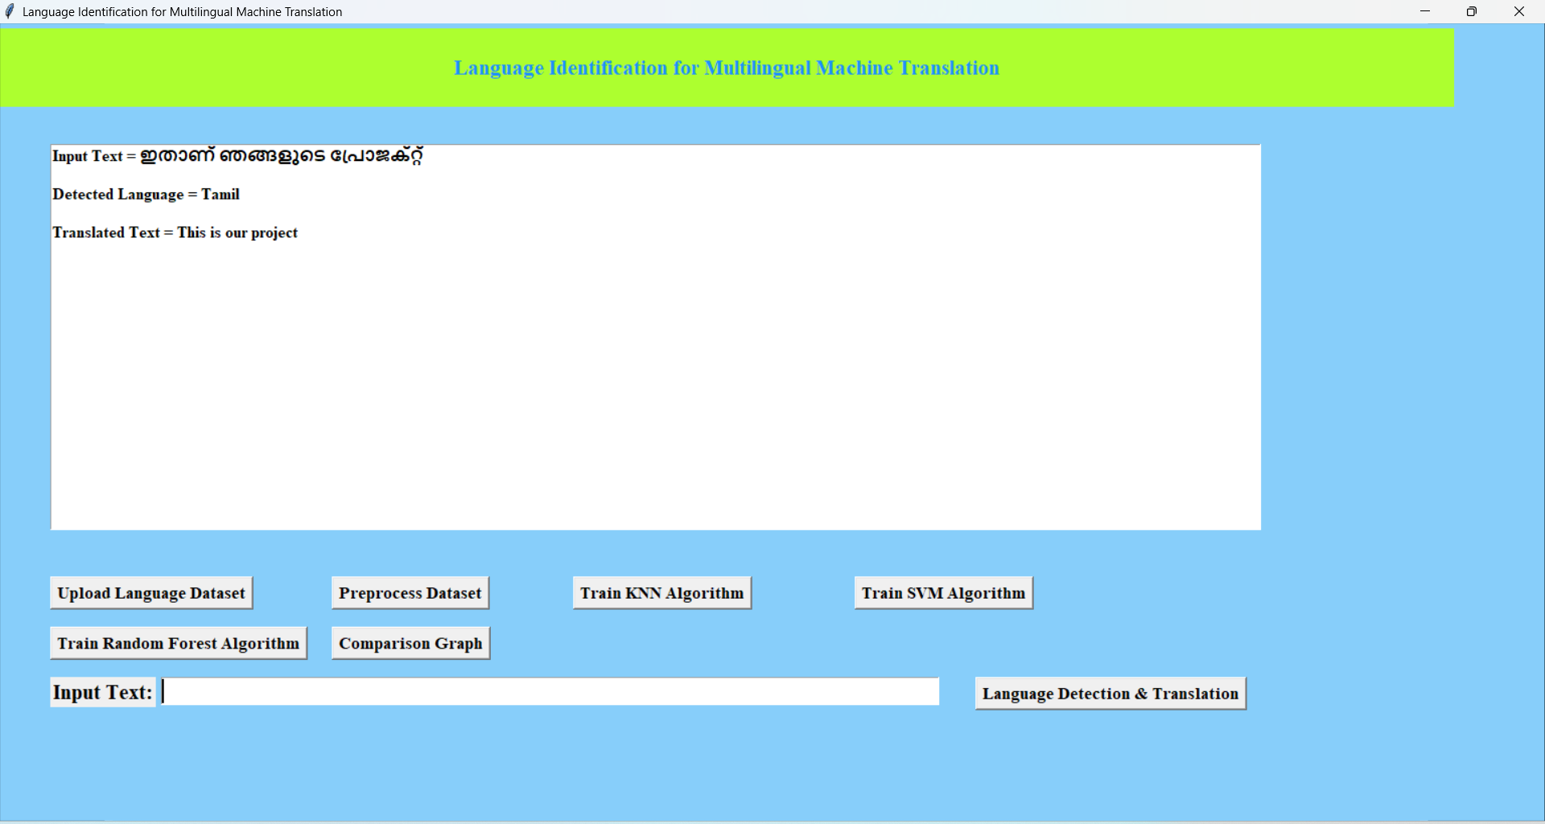
LANGUAGE IDENTIFICATION AND DETECTION

Slide 24
CONCLUSION
In conclusion, the proposed Language Identification (LID) system for Multilingual Machine Translation (MT) offers a highly efficient and innovative solution for addressing the complexities of multilingual environments.
By integrating multimodal inputs (text and audio), handling real-time code-switching, and incorporating dialect identification, the system ensures accurate language detection, paving the way for more precise translations.
Its use of confidence scoring and zero-shot learning enables robust performance, particularly for low-resource languages, while the feedback-driven improvement mechanism allows for continuous refinement.
Designed to scale for large applications like live translation, social media, and global customer support, the system sets a new standard in multilingual MT by providing both accuracy and adaptability in a diverse, multilingual world.

Slide 25
FUTURE SCOPE
The future scope of language identification for multilingual machine translation includes several exciting and impactful areas:
Real-Time Identification and Translation: Improving the speed and accuracy of language identification in real-time applications, such as live translation services and interactive multilingual systems.
Handling Code-Switching: Enhancing models to effectively identify and manage code-switching, where speakers mix languages within a single sentence or conversation, which is increasingly common in multilingual contexts.
Ethical and Inclusive Practices: Ensuring that language identification and translation technologies are designed and deployed in ways that respect linguistic diversity and cultural nuances, promoting inclusivity and fairness.
Integration with Other NLP Tasks: Combining language identification with other NLP tasks, such as sentiment analysis, named entity recognition, and summarization, to enhance the overall performance and usability of multilingual systems.

Slide 26
REFERENCES
S. K. B. R. G. et al. (2004), Language Identification in the Wild, IEEE Transactions on Pattern Analysis and Machine Intelligence.
L. J. & S. G. (2013), Multilingual Neural Machine Translation with a Shared Attention Mechanism, Proceedings of the Conference on Empirical Methods in Natural Language Processing (EMNLP).
D. M. et al. (2019), BERT: Pre-training of Deep Bidirectional Transformers for Language Understanding, arrive preprint arXiv:1810.04805.
P. et al. (2020), A Survey on Multilingual Neural Machine Translation, IEEE Transactions on Neural Networks and Learning Systems.
H. B. et al. (2021), Context-Aware Language Identification for Machine Translation, IEEE Transactions on Audio, Speech, and Language Processing.

Slide 27
THANK YOU

